Slide 1

Portfolio Optimization
Outline
The problem of portfolio optimization
Markowitz / CVar
Implementations
QP - SLSQP
GA
MINLP
CP-SAT
Mateo Lelong
Samy Yacef
Maxim Bocquillion
Aurélien Daudin
Khaled Mili
Bourse du Commerce

Slide 2
Portfolio Optimization
Outline
The problem of portfolio optimization
Markowitz / CVar
Implementations
QP - SLSQP
GA
MINLP
CP-SAT
Bourse du Commerce
Mateo Lelong
Samy Yacef
Maxim Bocquillion
Aurélien Daudin
Khaled Mili

Slide 3
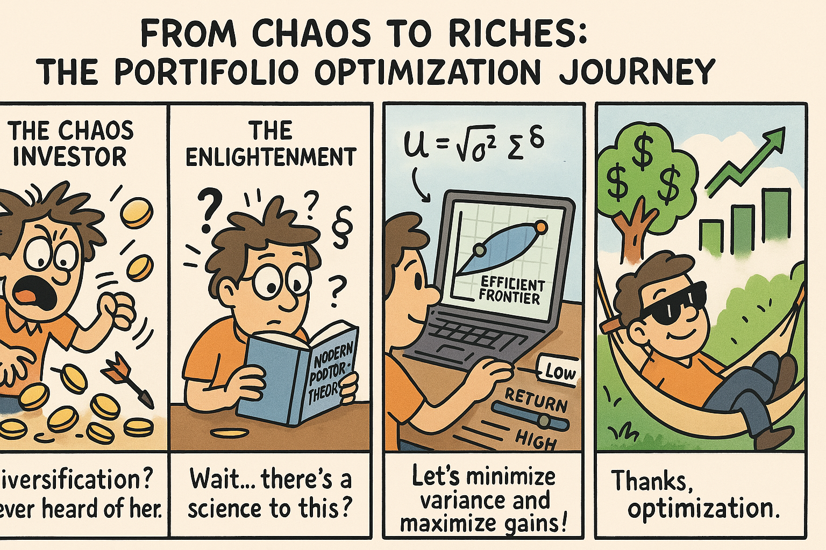

The Portfolio Optimization Problem

Slide 4

Mathematical Models
The Portfolio Optimization Problem

Slide 5
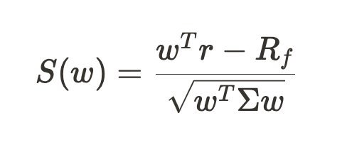
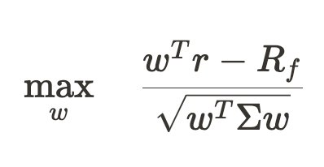
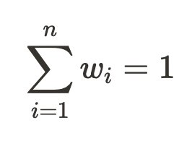

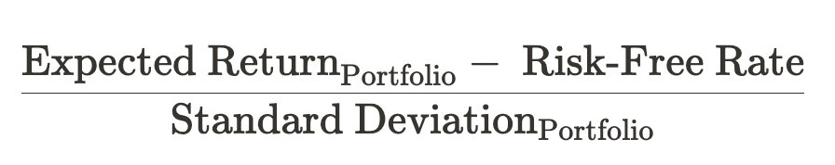
Markowitz Model Sharpe Ratio Maximization
Sharpe Ratio
Objective Function

Slide 6
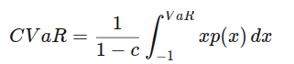
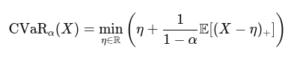
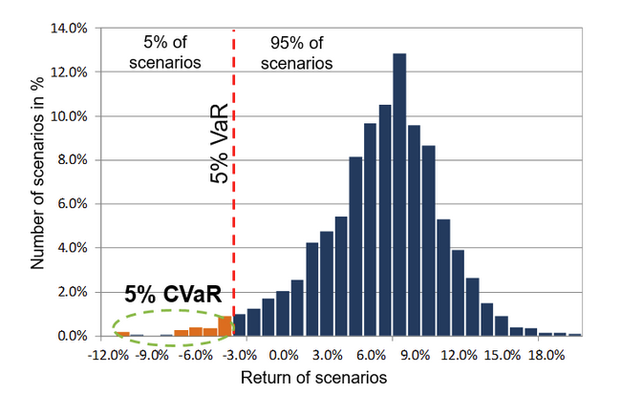
CVaR Model CVaR Minimization
Objective Function: Rockafellar-Uryasev
CVaR Formula

Slide 7

Implementations

Slide 8
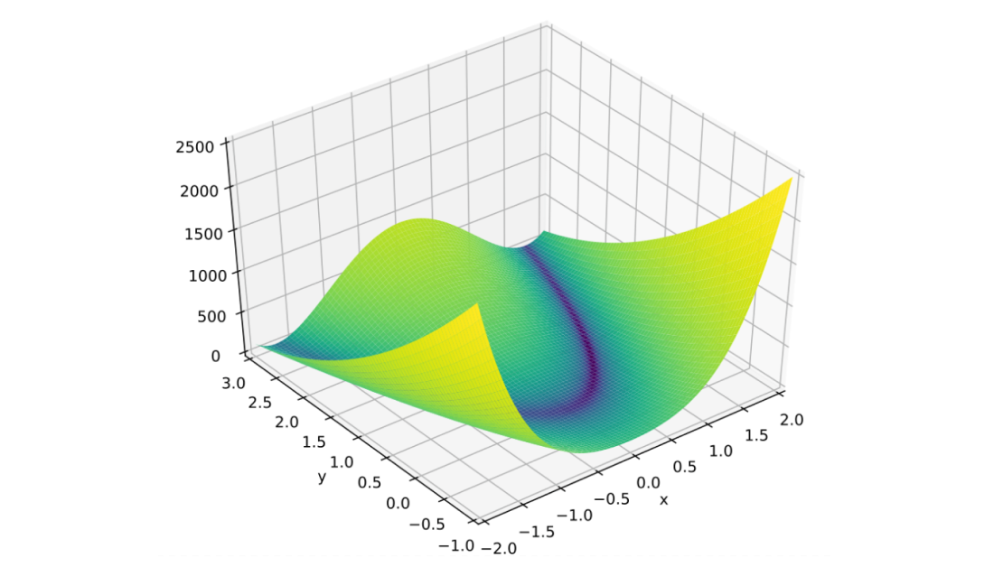
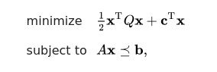
Generic QP Problem ​

Slide 9

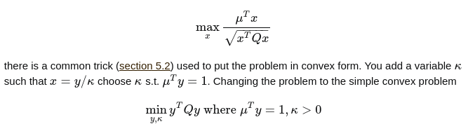
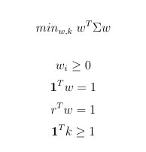
Interior Point Method​
Active Set​
Conjugate Gradient (some reformulation tointegrate inequalities)​
Augmented Lagrangian
QP Markowitz Reformulation
Problems: No cardinality, no risks

Slide 10

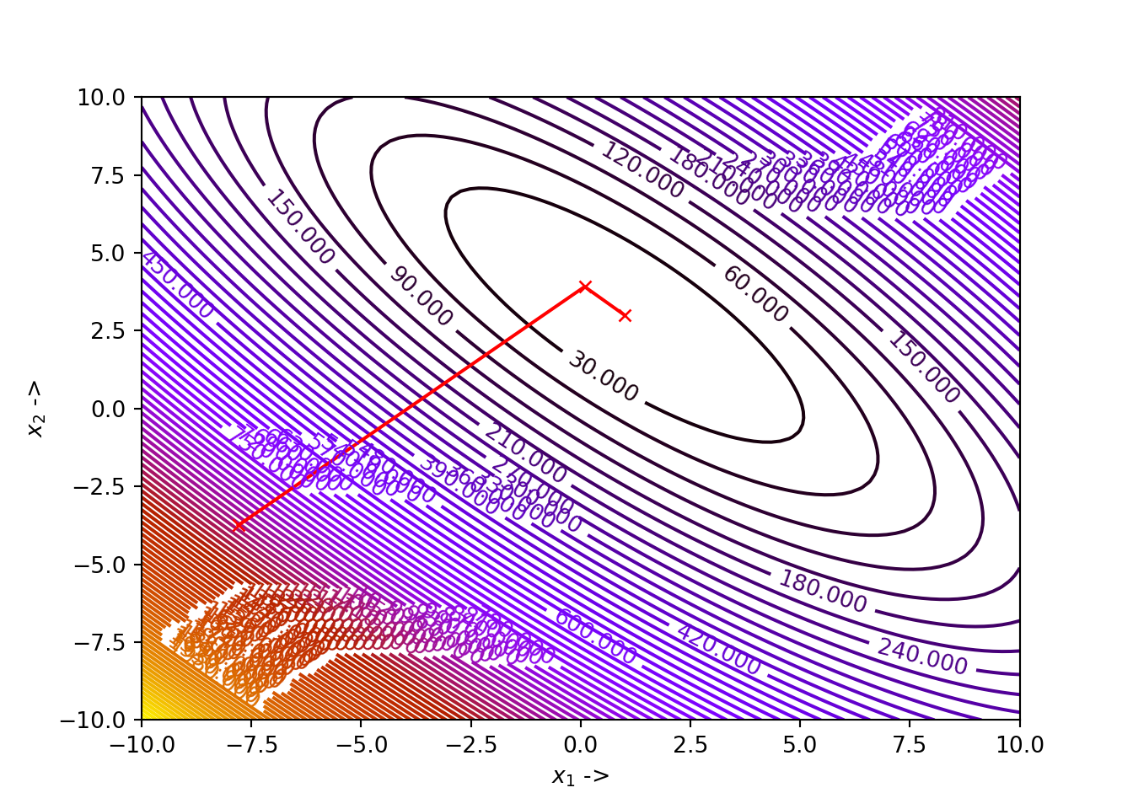
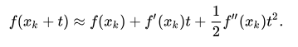
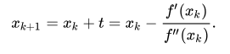
Non-Linear QP - SLSQP
Newton's Method
Problems: No cardinality

Slide 11
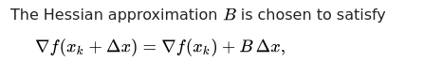
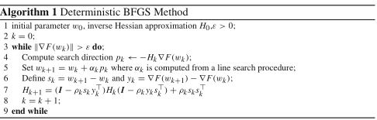

Non-Linear QP - SLSQP
BFGS Method (Quasi Newton)
SLSQP: solve QP until convergence using BFGS updates

Slide 12

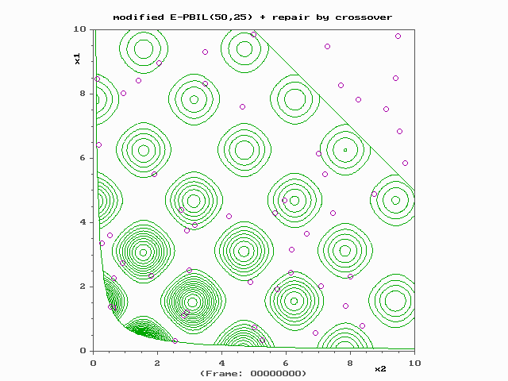
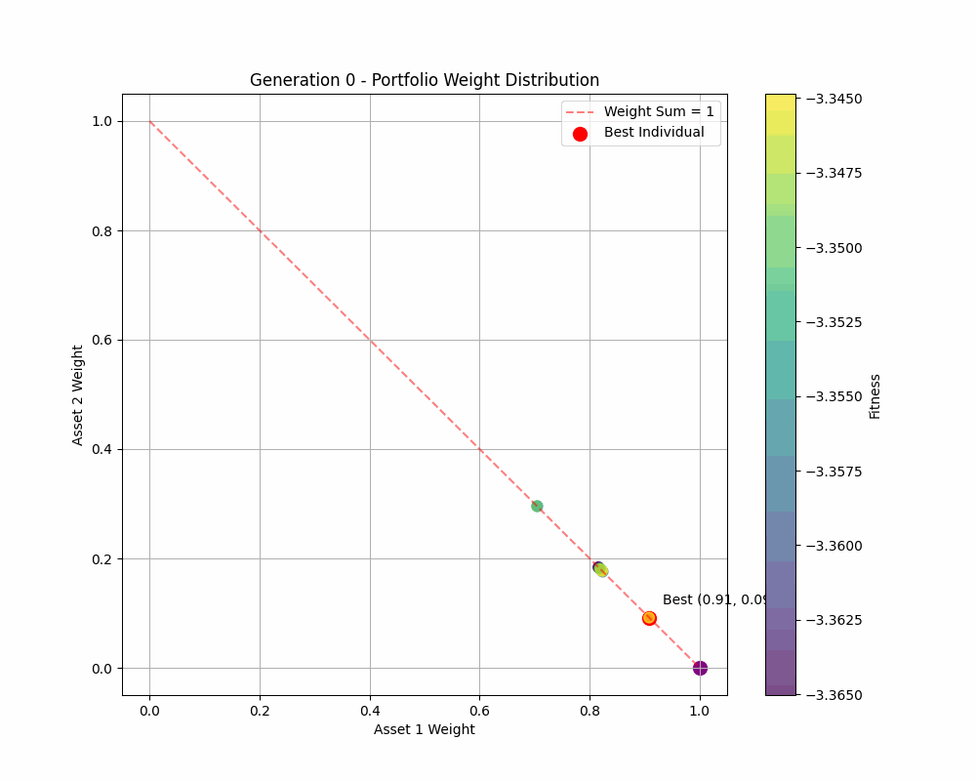
Evolutionary Algorithm - Genetic Algorithm

Slide 13
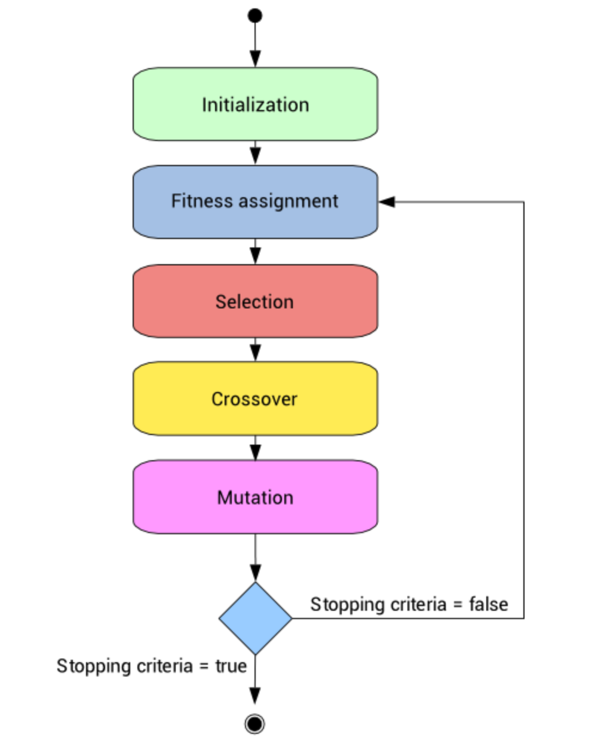
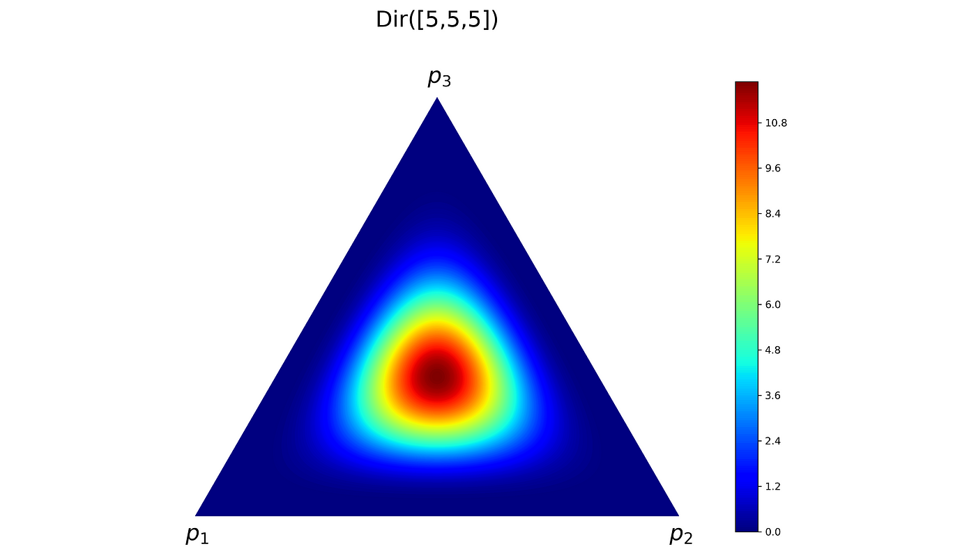
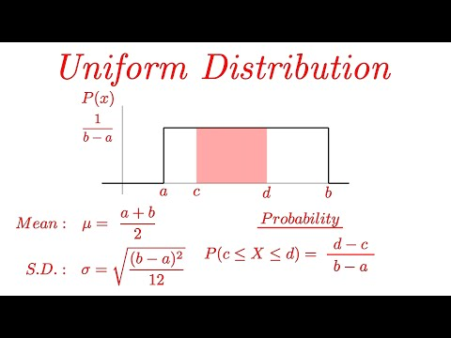
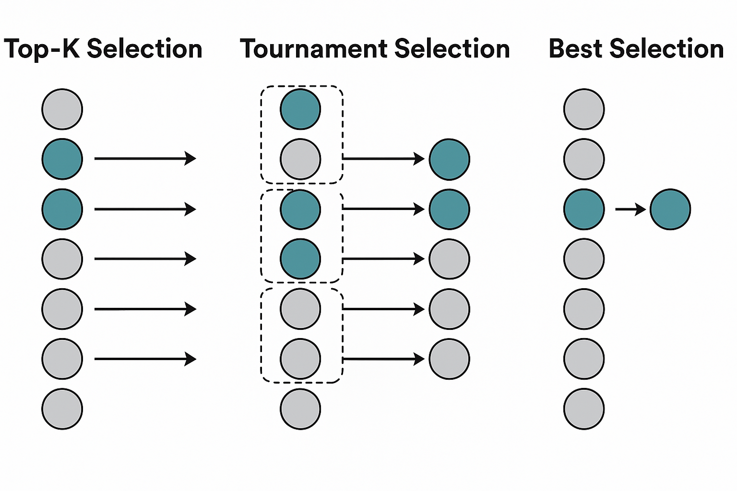
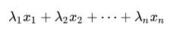
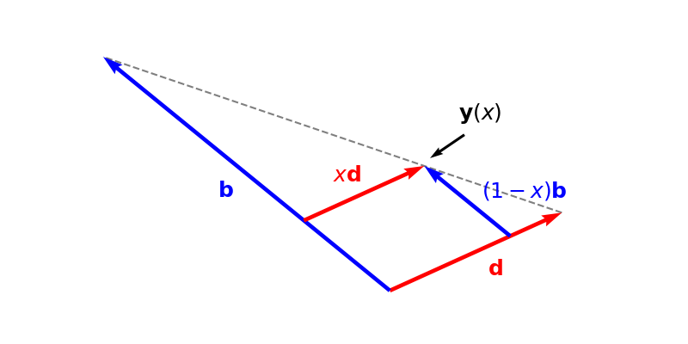
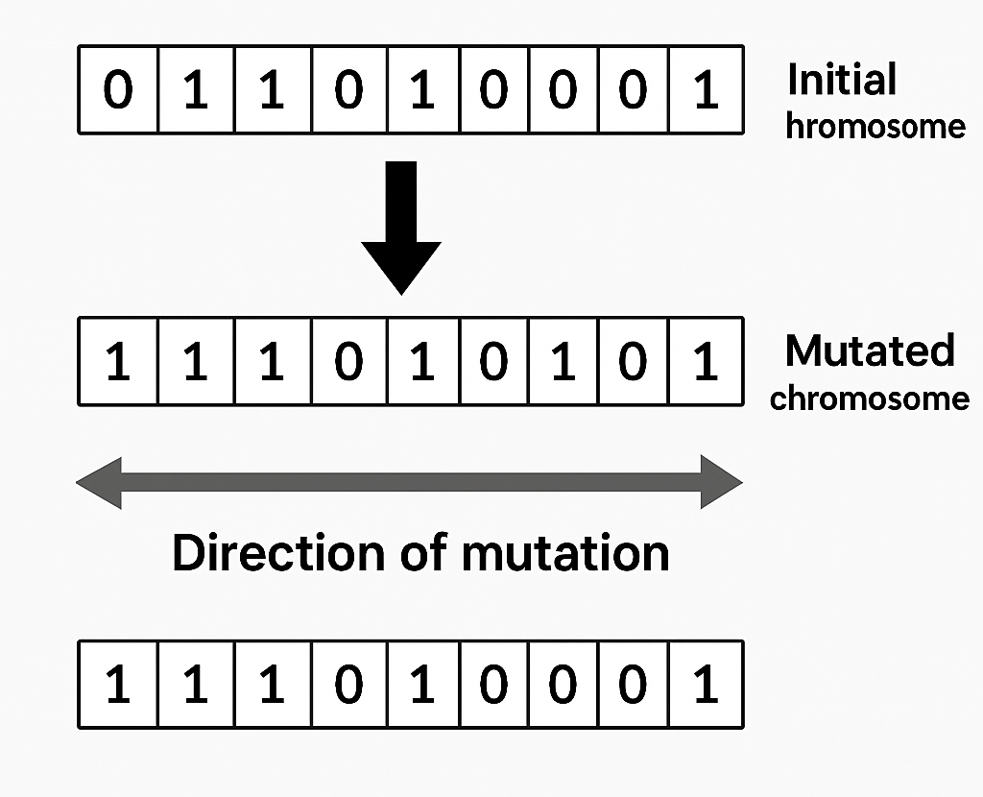
Evolutionary Algorithm - Genetic Algorithm
Sharpe Ratio
Dirichlet / Uniform
Top K / Tournament / Best
Convex / Arithmetic
Gaussian / Directional

Slide 14
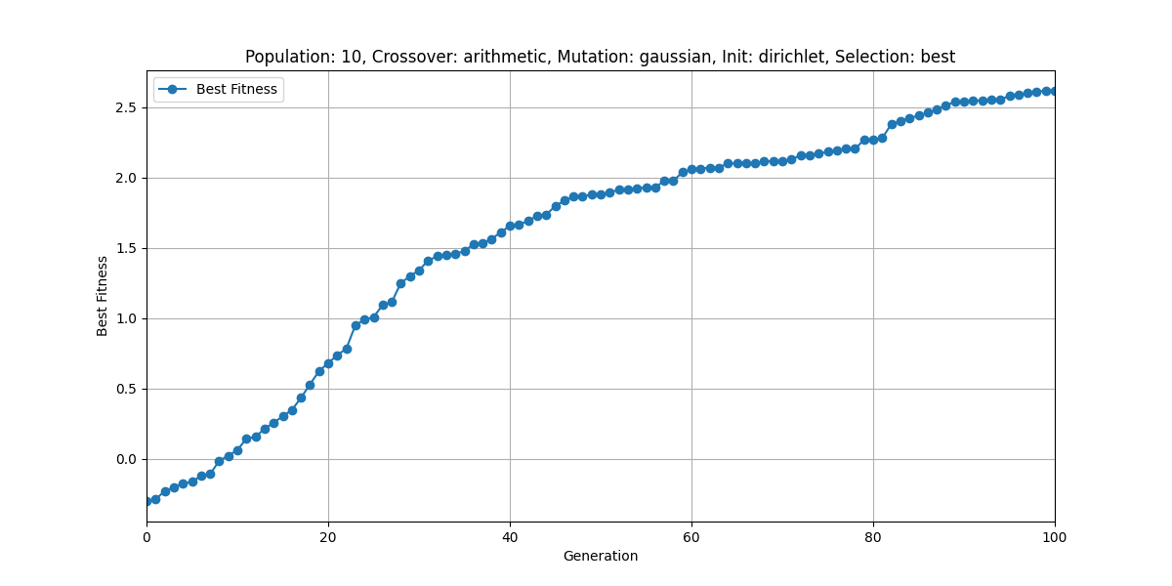
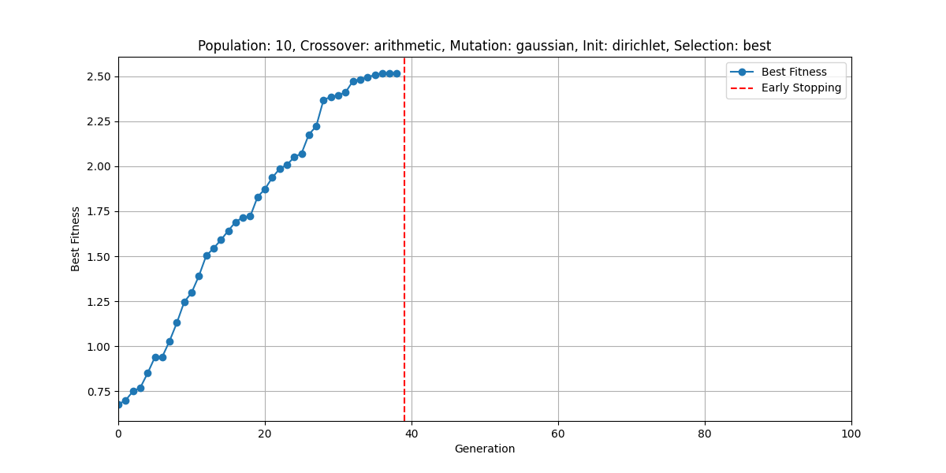
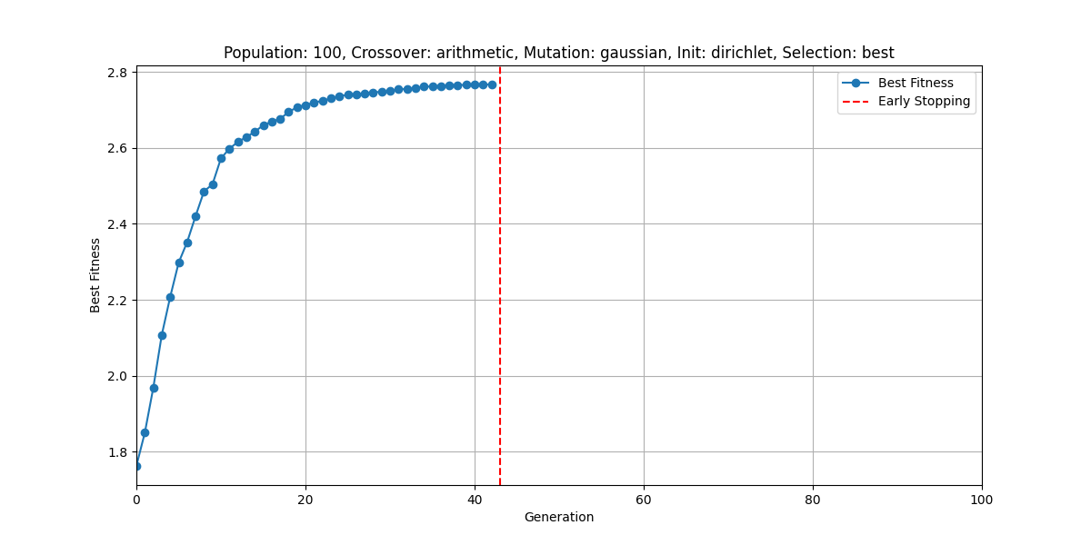
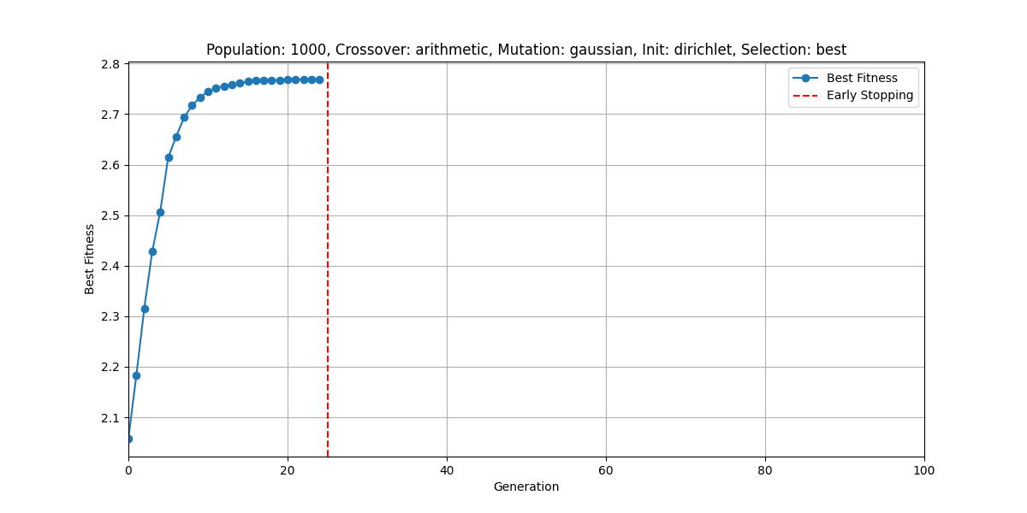
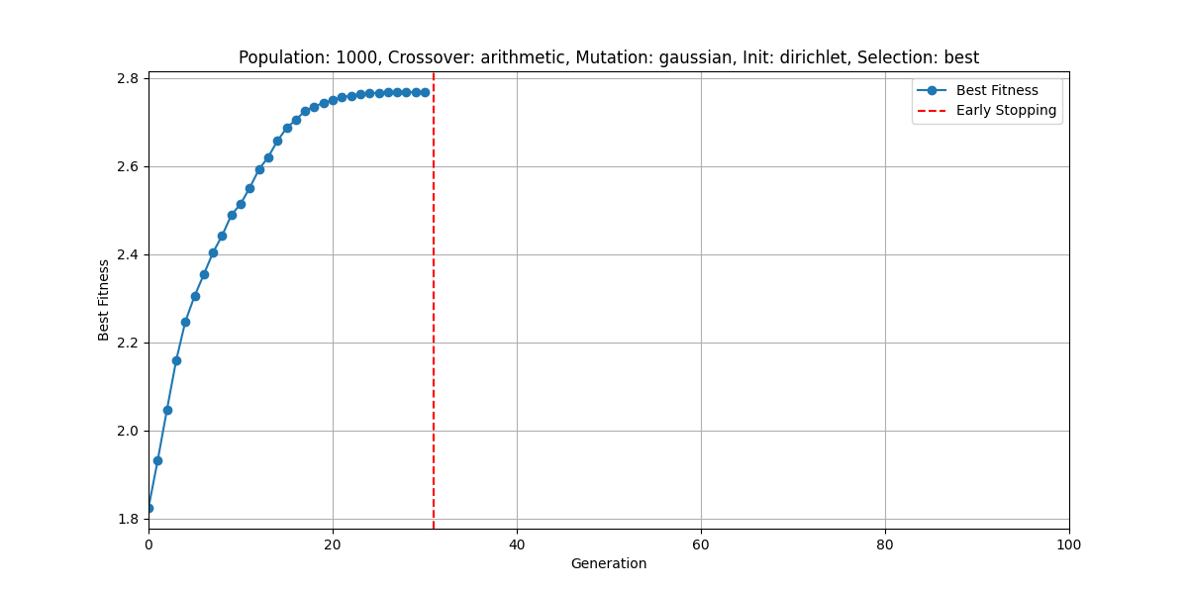
 | Convergence | Convergence with more mutations / crossovers | Convergence | Best Fitness | Time (s)
GA – 10 genomes |  |  | 100/40 | 1.67 | 0.6 - 2
GA – 100 genomes |  |  | 45/25 | 2.76 | 7 - 13
GA – 1000 genomes |  |  | 35/25 | 2.8 | 23 -50

Slide 15
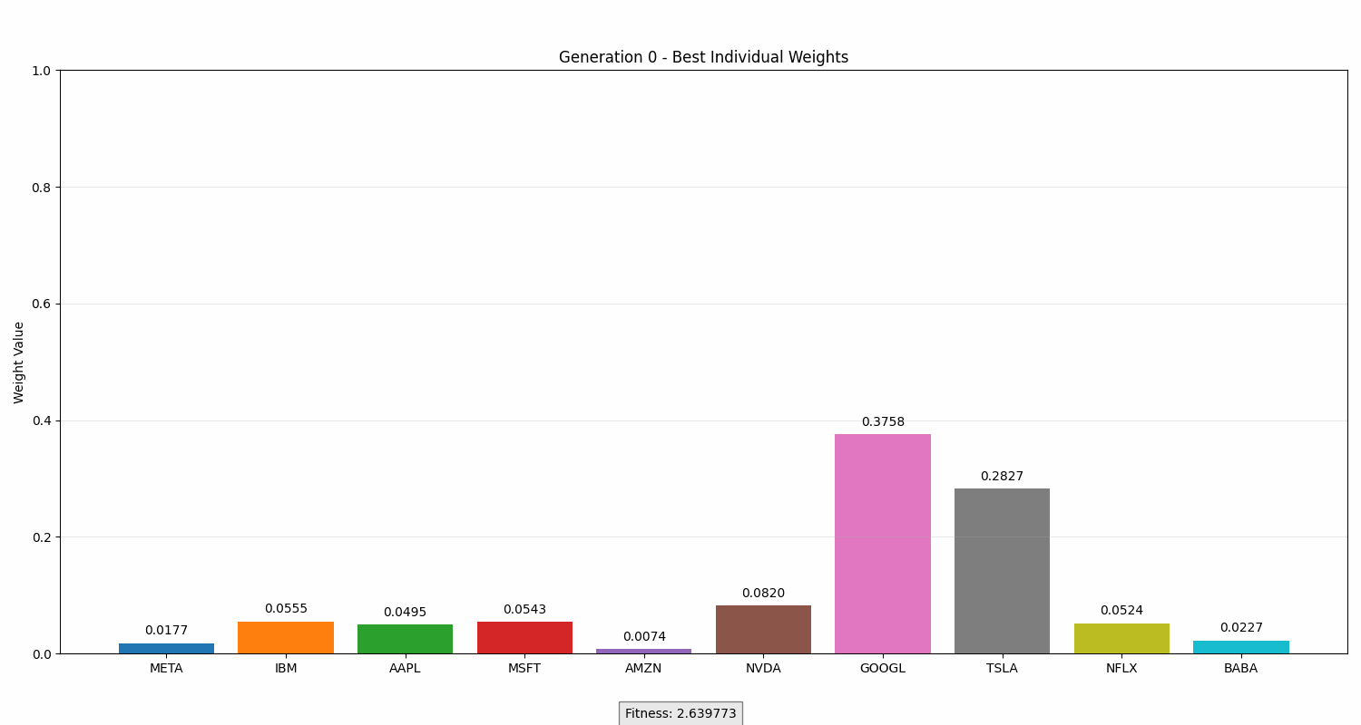
Evolutionary Algorithm - Genetic Algorithm
Problems: Local Optima in High dimensions, slow

Slide 16



CP-SAT
Optimize a portfolio by maximizing a surrogate Sharpe ratio
Expected Return: Weighted sum of asset returns Risk: Weighted sum of asset volatilities (standard deviations)
Tradeoff between excess return (after risk-free rate) and risk penalty using integer weights.
risk rate * (portfolio excess return) − non risk rate * (portfolio risk)​

Slide 17

Why CP-SAT ?
Portfolio solver, concurrently executes diverse algorithms and strategies, each with unique strengths and weaknesses.
Branch and Cut techniques, including linear relaxations and cutting planes
Lazy Clause Generation

Slide 18

Preprocessing Steps
Model Loading and Verification (constraints, variables, objective function) Pre-processing Presolve (domain reduction) Expansion of higher-level constraints Detection of equivalent variables and affine relations Substitution with canonical representations Variable probing

Slide 19
Solution Search Steps
Parallel Subsolvers Multiple solvers run in parallel, each with a unique strategy (e.g., aggressive restarts, focus on bounds, linearized models)
Feasibility Searchers Additional threads aim to quickly find any valid solution
Improvement Phase (LNS) Once feasible, local search heuristics (LNS) take over, rotating strategies in a Round Robin fashion to refine the solution
Optimality Any subsolver can find the optimal solution, some just get there faster

Slide 20
MILP/MINLP : Mixed Integers (Non-)Linear Programming
Integer Constraints
Binary Constraints (Do I select the asset ? Yes or No = 1 or 0)
Karush-Kuhn-Tucker (KKT) conditions
Define the feasibility space, describe the optimality
Newton's Method Iterative method to solve the KKT system matrix and find an approximation of the roots
Search direction Solving Δx = Tells the optimizer where and how far to move

Slide 21
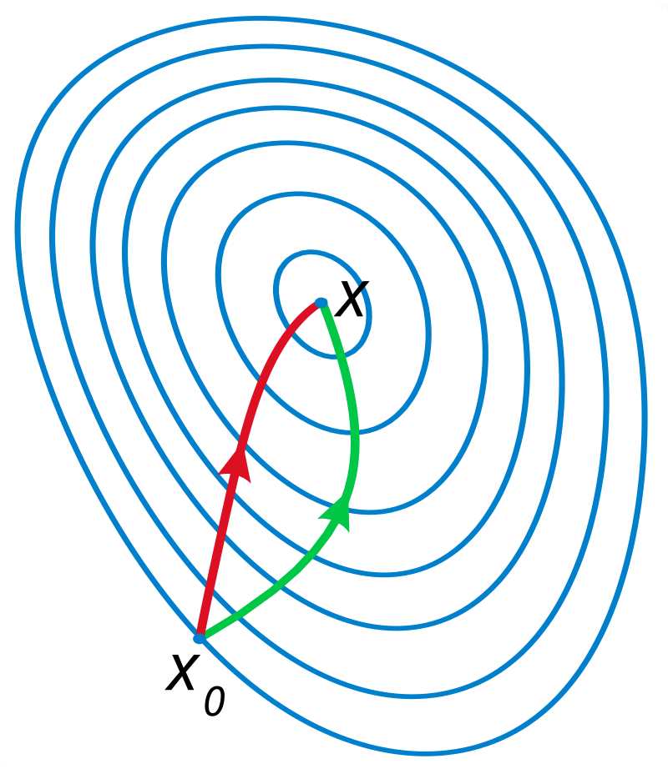
MILP/MINLP : Mixed Integers (Non-)Linear Programming
X
Newton's Method
X0
Gradient

Slide 22


User Interface

Slide 23
References
A review and comparison of solvers for convex MINLP
https://link.springer.com/content/pdf/10.1007/s11081-018-9411-8.pdf
https://www.centralcharts.com/fr/gm/1-apprendre/3-bourse/5-gestion-portefeuille/211-theorie-du-portefeuille-selon-markowitz
Hands on AI Trading , Jared Brod
https://www.mathworks.com/help/finance/mixed-integer-cvar-portfolio-optimization-problem.html
Artificial Intelligence Applied to Stock Market Trading: A Review
A comprehensive review of deterministic models and applications for mean-variance portfolio optimization
https://doi.org/10.1016/j.eswa.2019.02.011
Solving Mixed-Integer Quadratic Programming problems with IBM-CPLEX: a progress report
Twenty years of linear programming based portfolio optimization
https://www.sciencedirect.com/journal/european-journal-of-operational-research
https://moodle.epita.fr/course/view.php?id=1708
https://quant.stackexchange.com/questions/18521/sharpe-maximization-under-quadratic-constraints
An Overview of Stochastic Quasi-Newton Methods for Large-Scale Machine Learning(https://link.springer.com/article/10.1007/s40305-023-00453-9)

Slide 24
Documentation
Fred API: https://fred.stlouisfed.org/docs/api/fred/
SciPy: https://docs.scipy.org/doc/scipy/
PyGad: https://pygad.readthedocs.io/en/latest/
MEALPY: https://mealpy.readthedocs.io/en/latest/
Streamlit: https://docs.streamlit.io/
Quandl: https://pypi.org/project/Quandl/
NLopt: https://nlopt.readthedocs.io/en/latest/
Gekko: https://gekko.readthedocs.io/en/latest/
Ortools: https://developers.google.com/optimization/reference/python/sat/python/cp_model
CVXPY: https://www.cvxpy.org/index.html

Slide 25
THIS IS A SLIDE YOU CAN USE FOR YOUR SLIDES

